Slide 1




NEXT GEN EMPLOYABILITY PROGRAM
Creating a future-ready workforce
Team Members
College Name
Student Name :T.swathi
Student ID :912421104048
Shanmuganathan engineering college

Slide 2

CAPSTONE PROJECT SHOWCASE
Project Title
Voting Application using Django Framework-swathi-(4048,SEC)
Abstract | Problem Statement | Project Overview | Proposed Solution | Technology Used | Modelling & Results | Conclusion

Slide 3
Abstract : Django Online Voting System
We will create a pollster (voting system) web application using Django. This application will conduct a series of questions along with many choices. A user will be allowed to give voting for that question by selecting a choice. Based on the answer the total votes will be calculated and it will be displayed to the user. Users can also check the result of the total votes for specific questions on the website directly. We will also build the admin part of this project. Admin user will be allowed to add questions and manage questions in the application.
Source :

Slide 4
Problem Statement
Technologies used in the project: Django framework and SQLite database which comes by default with Django.
Implementation of the Project
Creating Project
Create Models
Create an Admin User
Create Views
Create Templates
Create Landing Page
Create routing inside the main urls.py file of the application
Testing of the Application
User Frontend
Source :

Slide 5
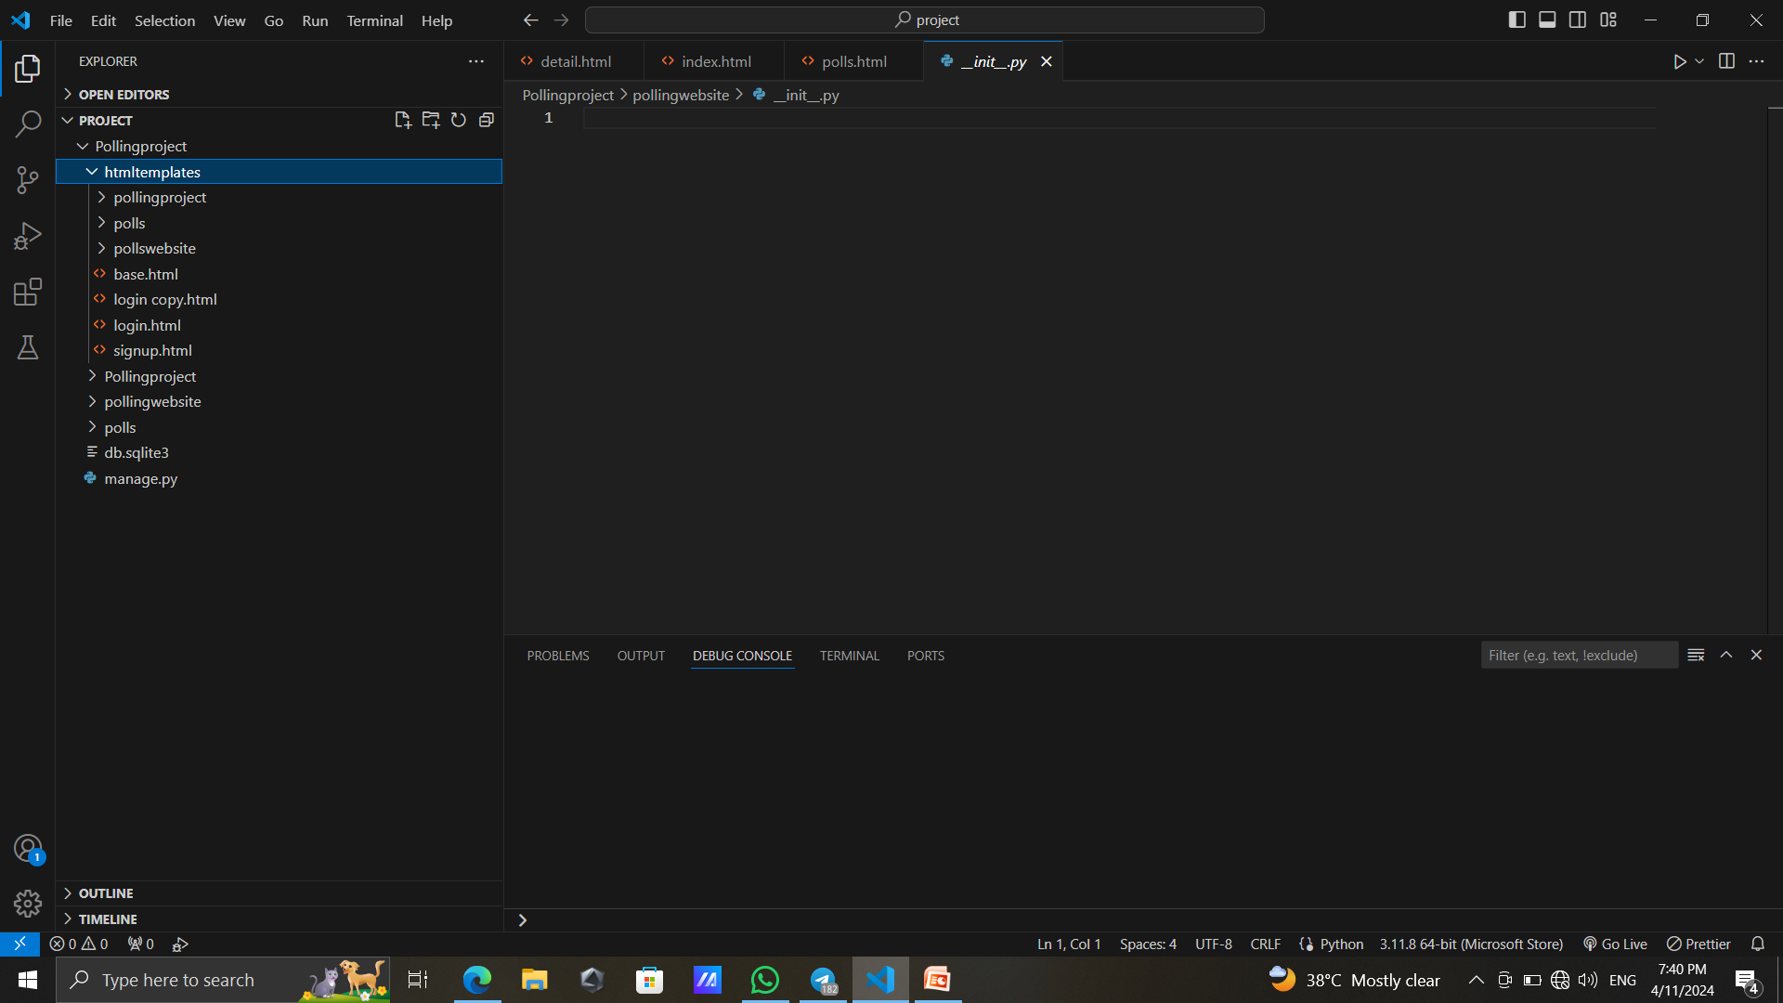
Folder formate
Source :

Slide 6
Create an Admin User
Step-1: Run the command given below to create a user who can login to the admin site.
python manage.py createsuperuser It will prompt username which we need to enter.
Username: geeks123
Now it will prompt an email address which again we need to enter here.
Email address: xyz@example.com
The final step is to enter the password. We need to enter the password twice, the second time as a confirmation of the first.
Password: ****** Password (again): ****** Superuser created successfully. Now we can run the server using the same command python manage.py runserver and we can check our admin panel browsing the URL http://127.0.0.1:8000/admin .
.
Source :

Slide 7
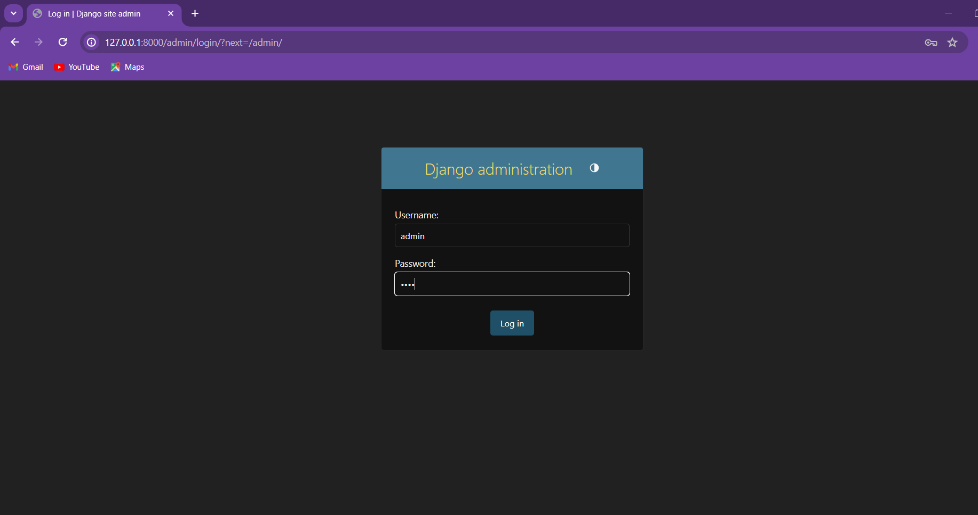

Slide 8


Technology Used
Front-end
Back-end
Source :

Slide 9
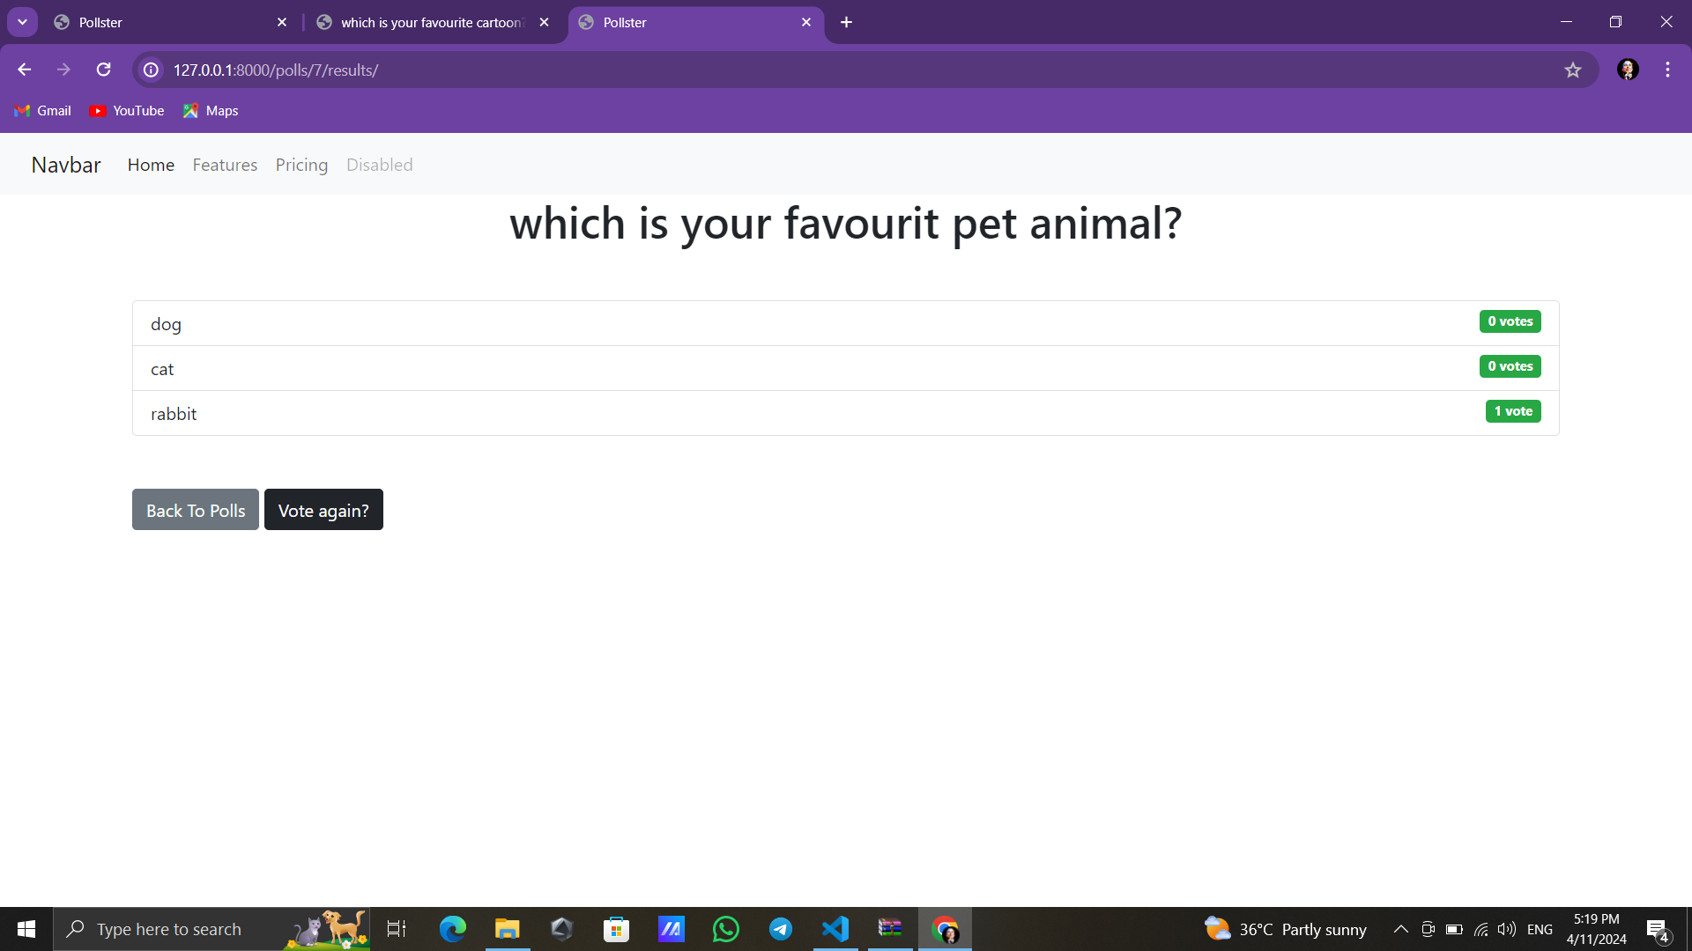
Modelling & Results
Source :

Slide 10
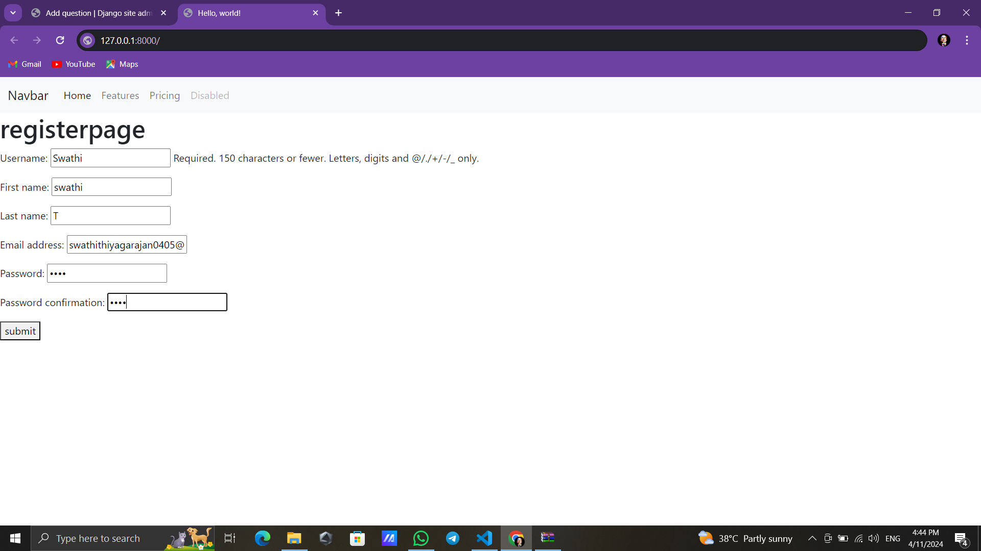
Register page

Slide 11
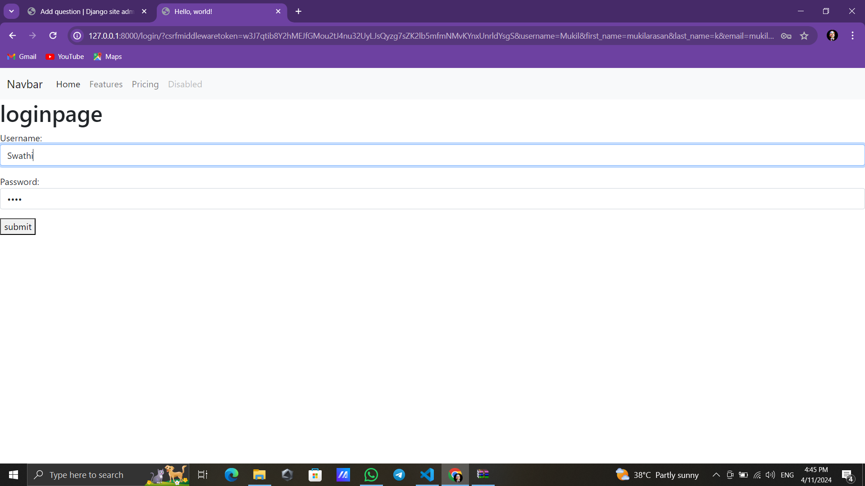
Login page

Slide 12
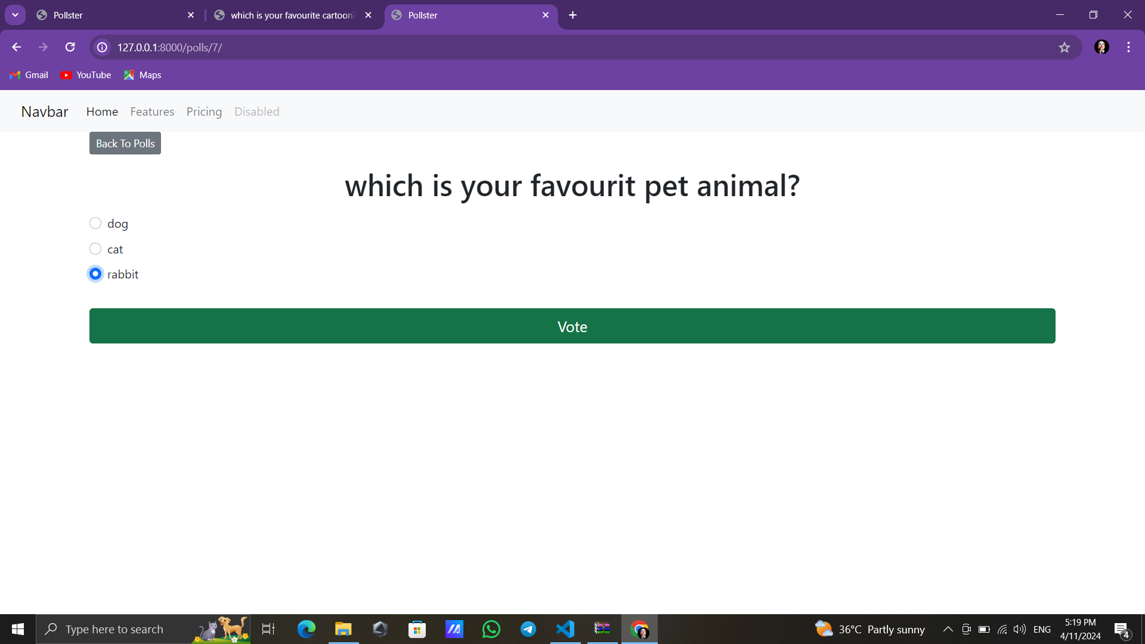
Question-page

Slide 13
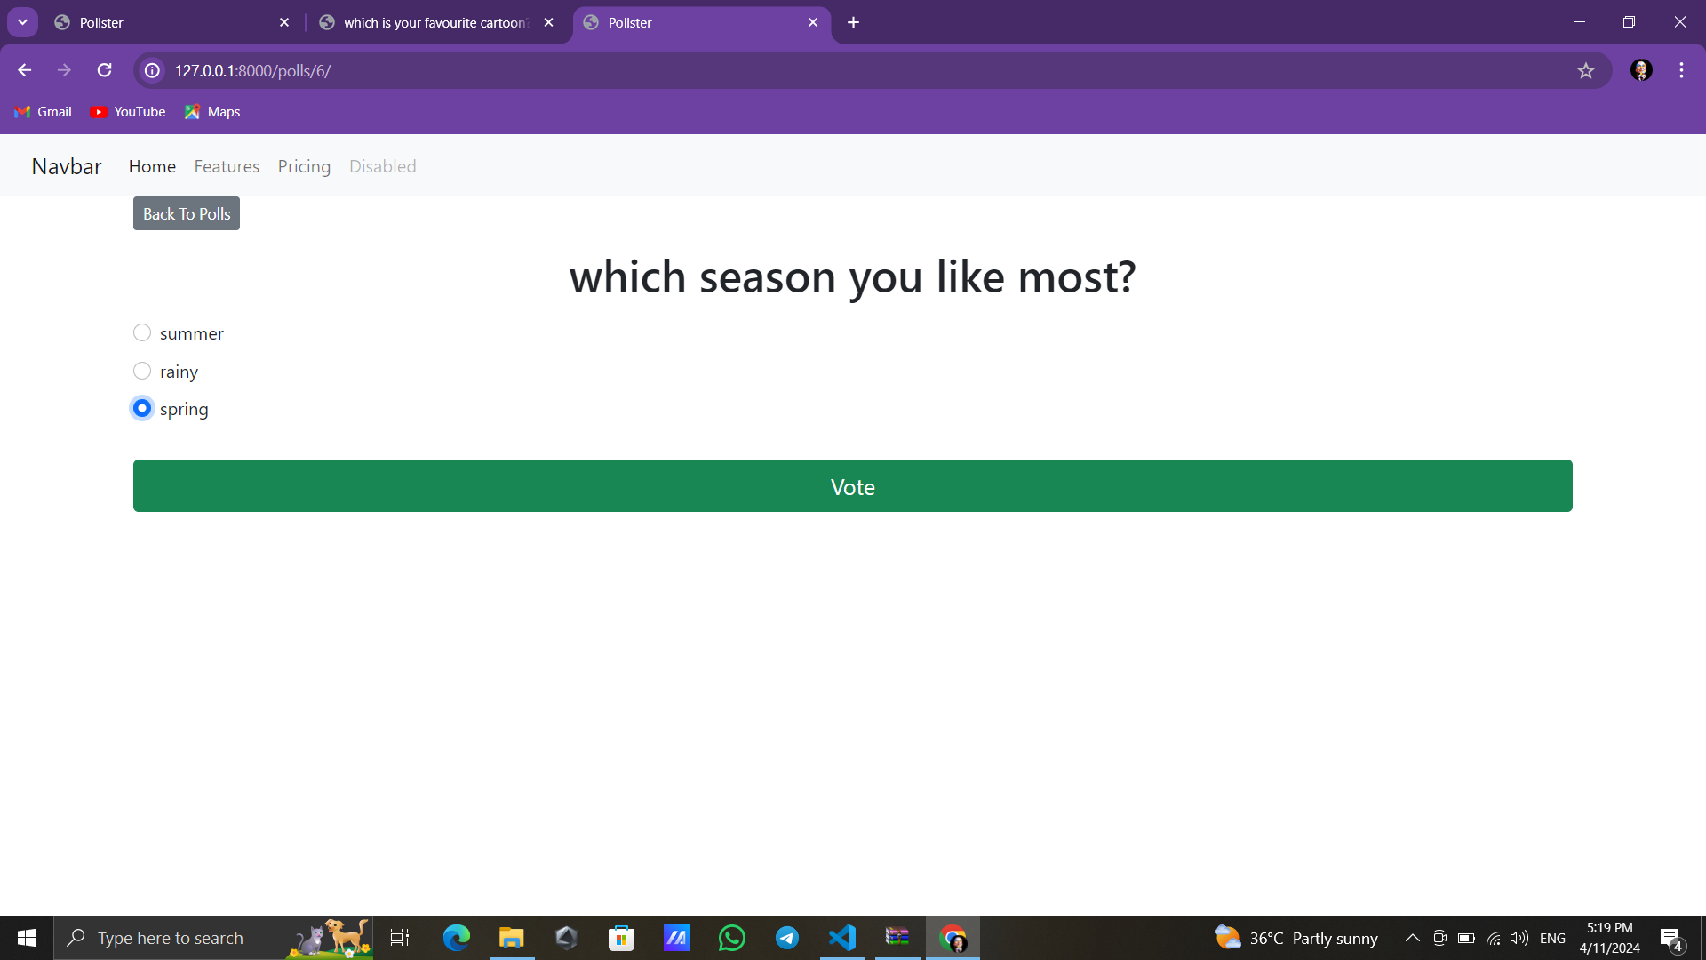
Question-page

Slide 14
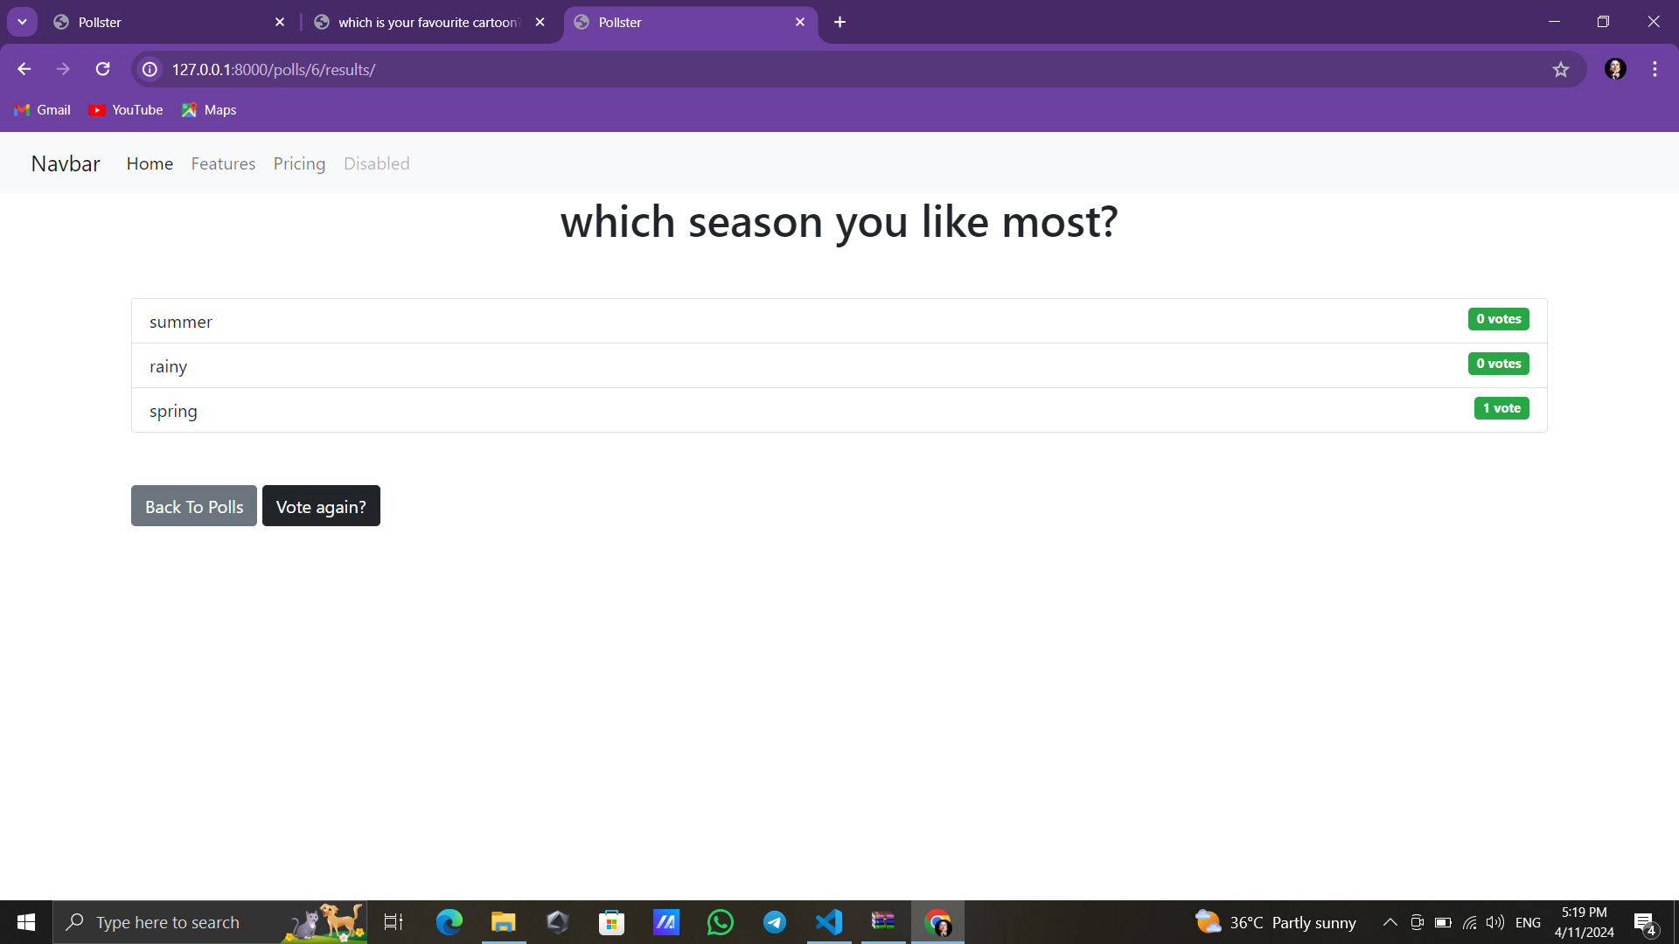
Result-page

Slide 15
Future Enhancements:
User Authentication:
Implement user authentication to allow only registered users to vote.
Associate each vote with a user to prevent duplicate voting.
Multiple Choice Options:
Allow users to select multiple choices for a single poll.
Implement validation to ensure users do not exceed the allowed number of choices.
Real-Time Updates:
Use WebSockets or server-sent events to provide real-time updates of poll results without requiring page refreshes.
Improved UI/UX:
Enhance the user interface with modern design principles and responsive layouts.
Implement client-side validation for a smoother user experience. polls.

Slide 16
Conclusion
In conclusion, the Django polling application offers a comprehensive solution for conducting polls with various advanced features to enhance user experience and functionality. By leveraging Django's powerful framework, along with modern frontend technologies and third-party services, we've created a robust platform for managing polls and engaging users.
With user authentication in place, only registered users can vote, and each vote is associated with a specific user, preventing duplicate voting. The application allows users to select multiple choices for a single poll, with validation ensuring they do not exceed the allowed number of choices. Real-time updates are facilitated through WebSockets or server-sent events, providing users with instant feedback on poll results without requiring page refreshes.
Source :

Slide 17
Thank You!
Notes:
Thank You !!

